Slide 1

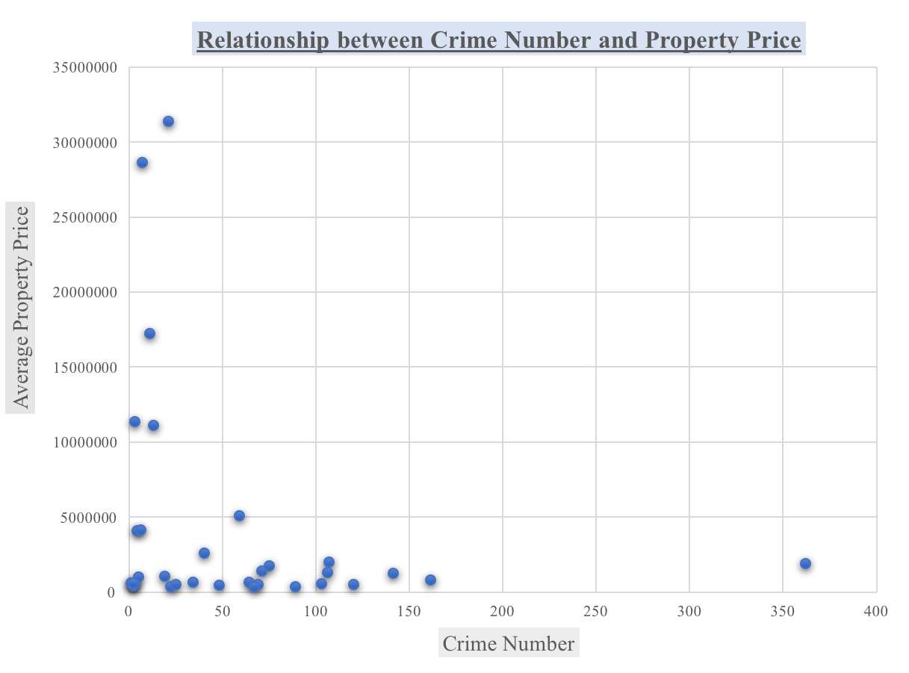
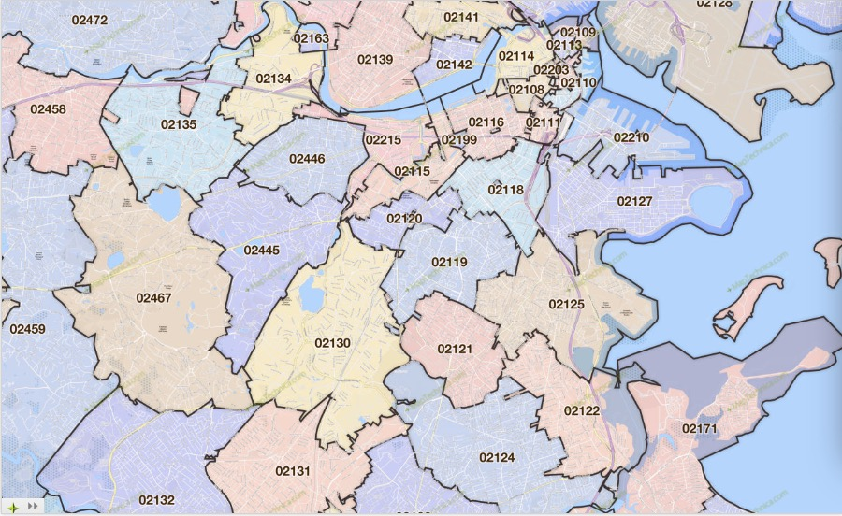
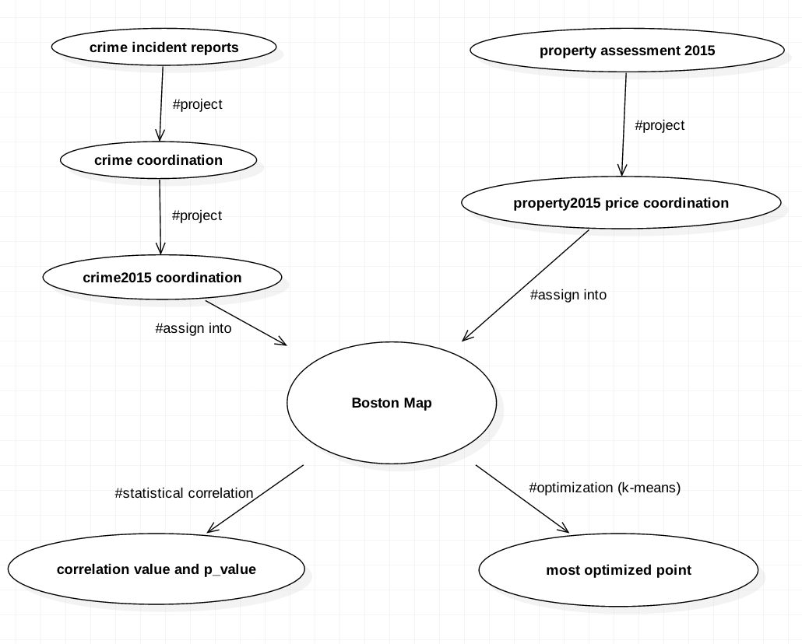
The Impact of Crime on Property Values Xiaotong Niu, Po-Yu Tseng
Boston University
CS 591 L1
Spring 2017
K-Means
For the k-means part, we want to find the most optimized point where the property is the cheapest, while at the same time, the safest (farthest from crime incidents). To do so, we input “crime_15coordination” to our k-means function and find the most optimized coordinate. And we correspond the coordinate back to polygon and we claim the zip code we get is the area where people can obtain property that is both the cheapest and the safest. The zip code we obtained is “02119”.
Introduction
Nowadays, people are more concerned in their living qualities, especially for a city that has as many people as Boston, and one of the main determinants of choosing places to live in residents’ minds is the amount of crime incidents that has happened in a certain area. In this project, we attempt to analyze the relationship between property prices of the year 2015 and the number of crime incidents that happened in 2015 in Boston area. We use Relational Paradigm to extract certain data from City of Boston Data Portal: Property Assessment 2015 and Crime Incident Reports. First, we assume higher property price will lead to lower number of crime incidents. To check our assumption, we use statistical analysis to find if the correlation value between them is negative, how strongly they are correlated, and we also look at the p-value to check the accuracy of our correlation value. Second, we use k-means technique to find the most optimized point where the property is the cheapest but safest, which means that the amount of crime incidents happened around that point is the smallest.
Overall, we implement two techniques: statistical analysis and optimization(k-means) to study the relationship between the 2015 property price and the number of crime incidents in Boston area.
Statistical Analysis
For the statistical analysis part, we want to find the correlation between property price and number of crime incidents, and we are expecting that higher property price will lead to lower number of crime incidents. We first use the definition of r-tree and polygon to correspond “property15_price_coordination_float” to “zip_to_coor”, compute the number of properties and the average price of properties in each zip code, and the result shows all the zip codes along with its corresponding average property price in Boston area. Second, we also use the same definition we mentioned earlier to correspond “crime_15coordination” to “zip_to_coor”, compute how many crime incidents happened within each zip code, and the result will show all the zip codes along with its corresponding number of crime incidents. Finally, we find the correlation between the average price of properties and the amount of crime incidents, and the number we got is:
-0.246.
Conculsion
The correlation value, -0.246 shows that property value and crime incident are indeed in a negative relationship, which matches our assumption. However, | (-0.246)| also shows that they are weakly related, and the p- value we obtained is very high. Moving forward with this project, we should consider factors more thoroughly that would also influence on crime numbers such as population density, school districts or police districts. Furthermore, due to time constraint, we were only able to run the small portion of our crime data, which might outcome the unideal correlation and p value. So we are assuming that we will obtain the better correlation and p value if we run more data on crime in the future.

